Slide 1
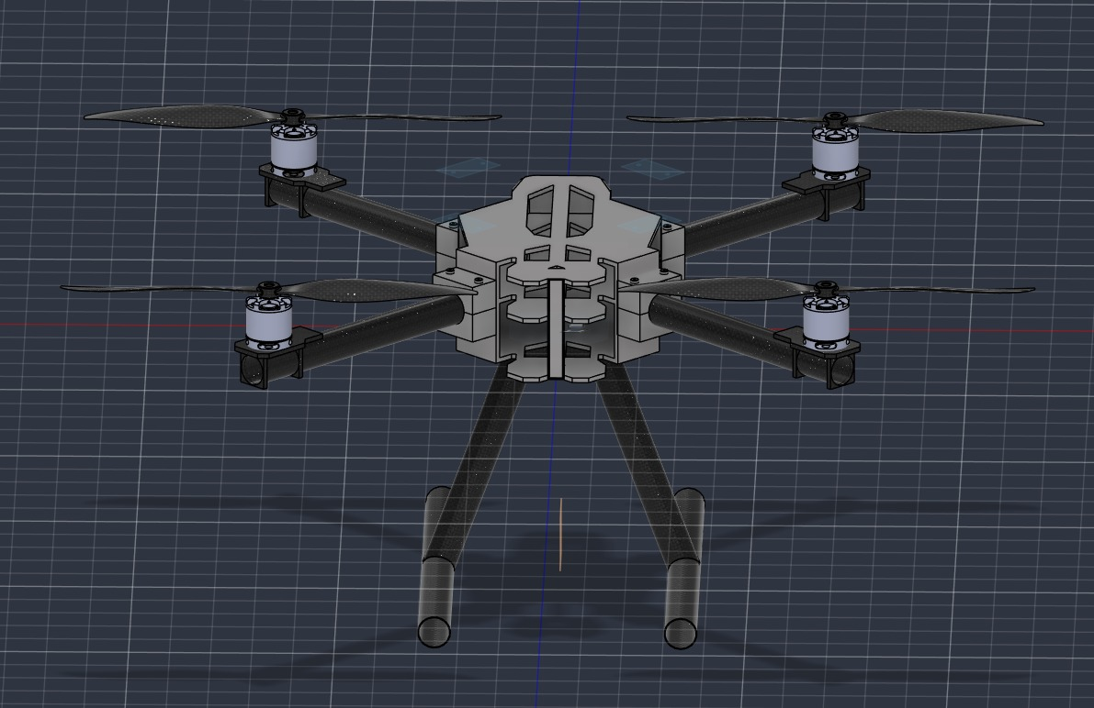
CROP HEALTH MONITORING DRONE
TEAM BASH
FIRST YEAR TRACK SPECIAL – ORION HACKATHON 2026

Slide 2
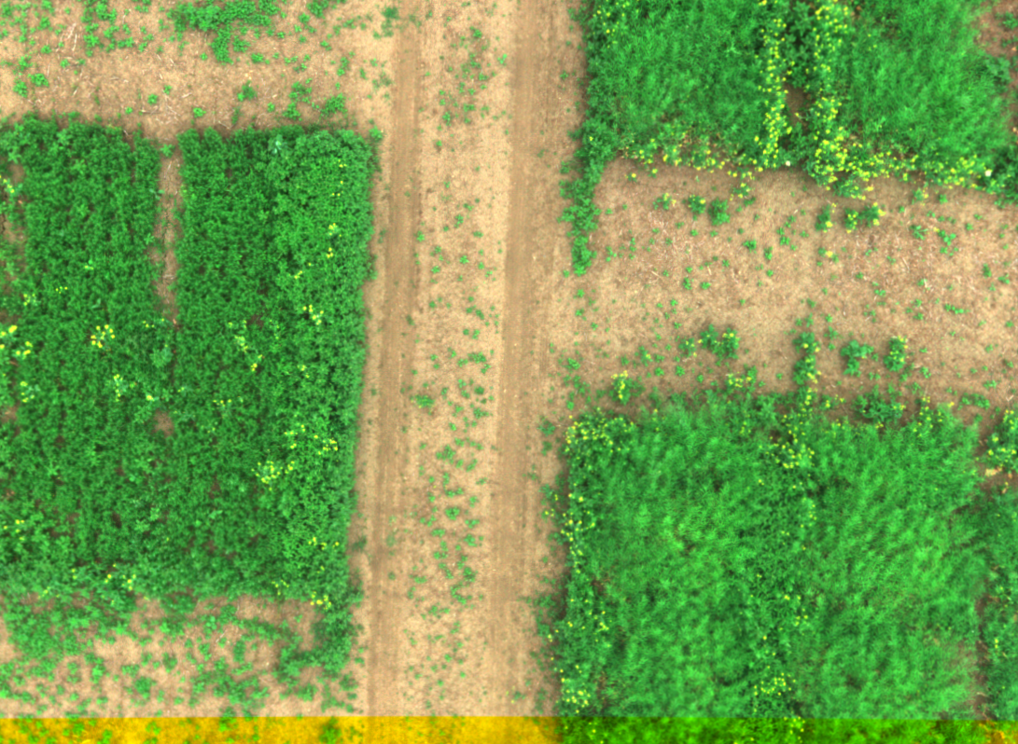
PROBLEM
STATEMENT
Mission: Design a small survey drone that photographs a 5 ha farm to spot unhealthy crop patches.
Requirements. Multirotor or small fixed-wing (your choice, with a short justification); 30 min endurance; 300 g camera payload (RGB or NIR); wind up to 5 m/s; take-off weight under 5 kg
Also required. Plan a simple lawnmower survey path, and estimate the area covered per flight from speed, altitude and camera field of view.

Slide 3

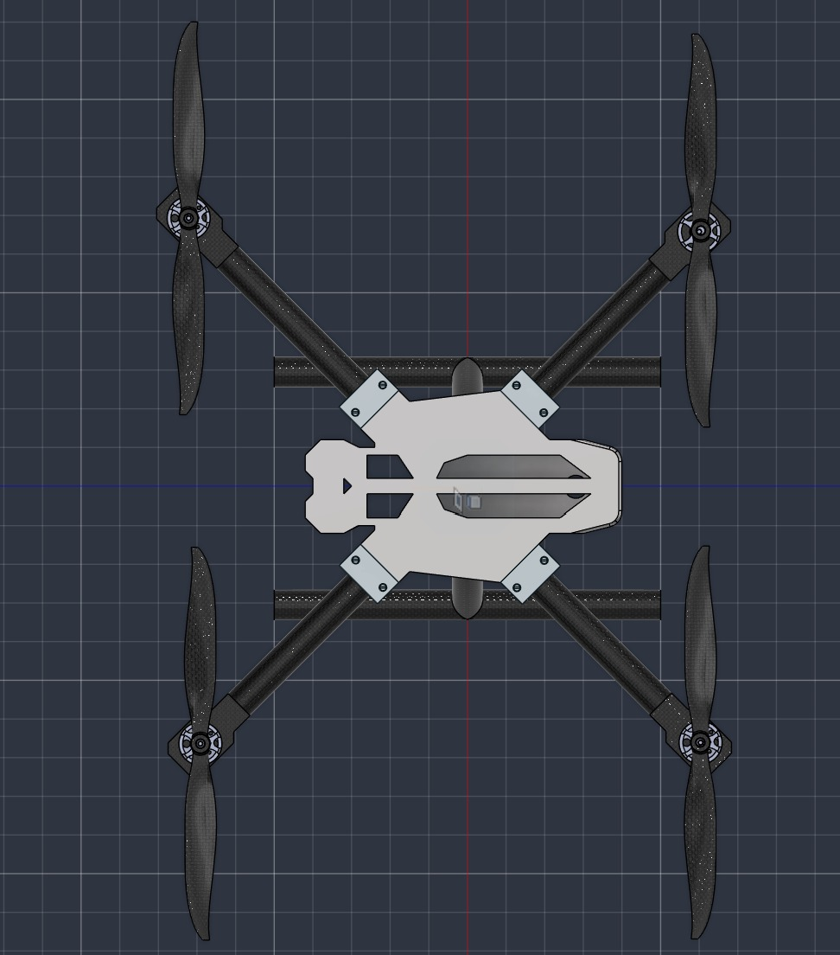
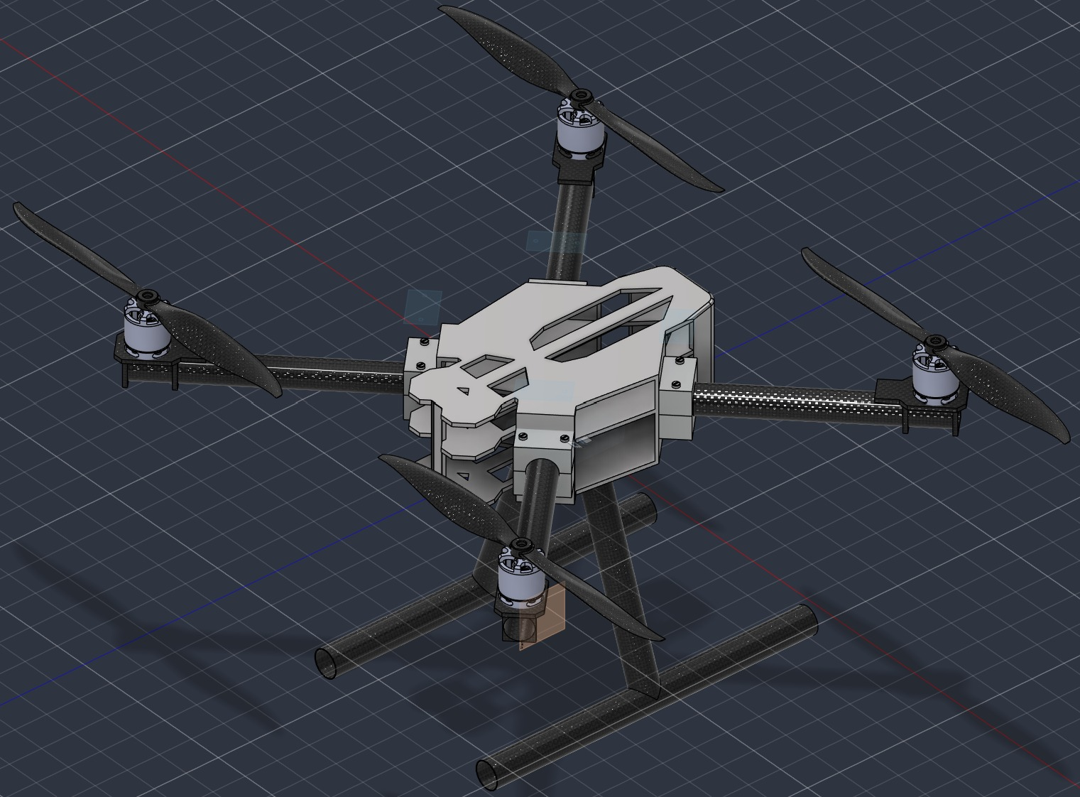
CAD MODELS
Isometric View of the Drone
Top View of the Drone

Slide 4
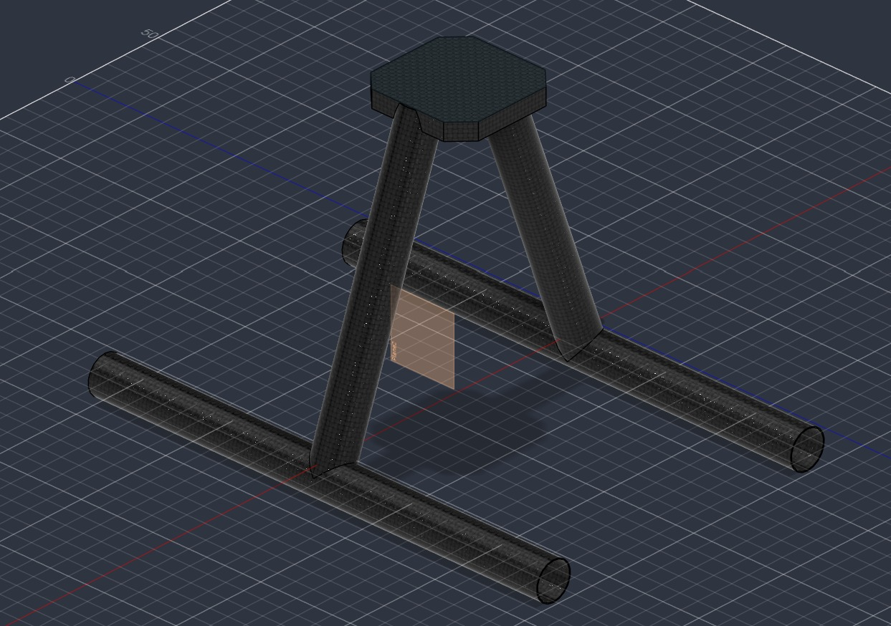
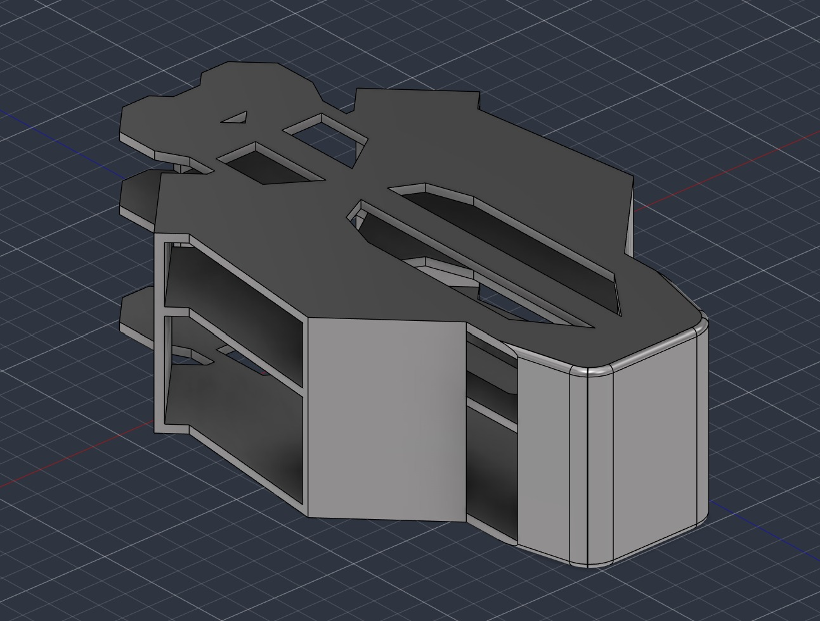
Isometric View of the Stand
Isometric View of the Main Body

Slide 5
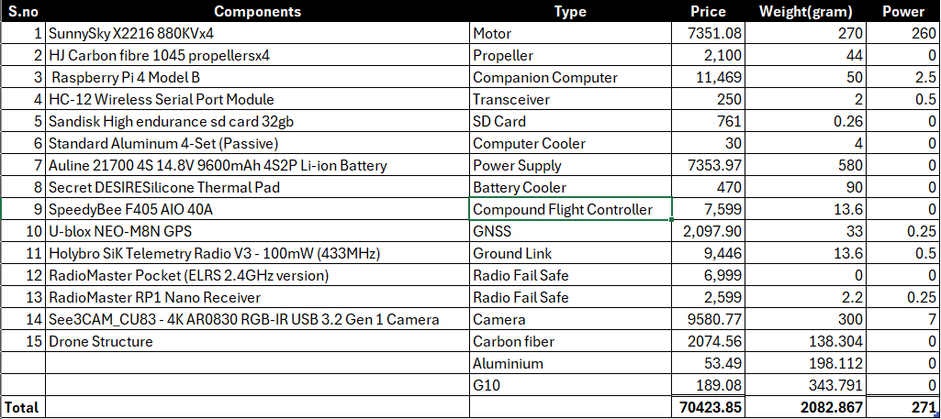
LIST OF COMPONENTS

Slide 6
Cnn Training
PreProcessing of NDVI and VARI formulae
Feature Stacking
CNN training
Data input from Drone
Final Output

Slide 7
CONCLUSION
The UAV has been prepared keeping in mind of the following points:
Scalability
Feasibility
Real-Life Scenarios
Provide Solution to all the given tasks in the Problem Statement
EXPLORE THE UNREACHABLE,
SEE THE UNSEEN,
AND DOCUMENT THE UNDOCUMENTED!!
~Elizabeth davis

Slide 8
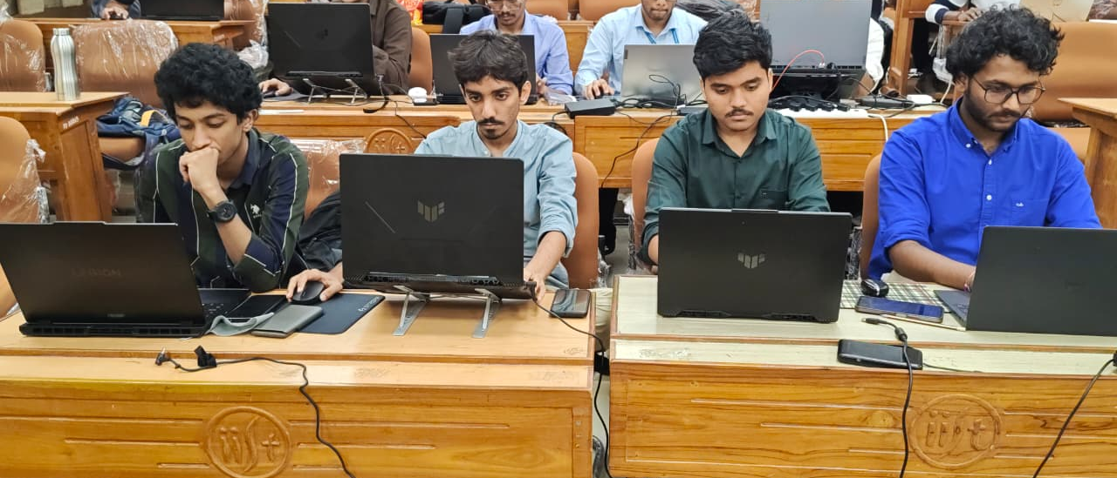
Thank you
S Kalaiventhan | Shreshth Sharma | Avrodeep Ghosh | abhinav

